Slide 1
UE17CS490A – Capstone Project Phase – 1
Project Progress Review #2
(Project Requirements Specification and Literature Survey)
Project Title : Intelligent Fashion Generation and
Retrieval System
Project ID : PW21KS09
Project Guide : Mr K.S. Srinivas
Project Team : Daksha Singhal PES1201700847
Kavya Khatter PES1201701136
Adithya Vardhan PES1201700788

Slide 2
Abstract and Scope
Intelligent Fashion Generation and Retrieval System
The fashion industry has always been one of the most lucrative markets in terms of products and design. Every designer is always looking for new ways to come up with ideas and inspirations. Every new design and concept could be a new trend in fashion. In this project, we will discuss the applications of Generative Models to train and develop a vast array of fashion apparel, given an adequate dataset. Characteristics such as texture, shape, design and material are some of the parameters that we take into consideration while creating variations in the output.Features, specific to a designer, can be achieved by loading the previous works of the designer into the model.
Such applications would find an interesting use case in designer boutiques such as H&M and ZARA as well as existing online boutiques such as SHEIN.

Slide 3
Suggestions from Review - 1
Provide the suggestions and remarks given by the panel members.
Finalizing the dataset for fashion Generator.
Progress
At each stage, datasets differs with regard to the model requirements.
In the preprocessing stage,for the bounding box approach a set of 500+ images containing different e-commerce products like shoes, tshirts, dress etc with their respective coordinates of the bounding box is used.
For training the model for generating images Kaggle Product Images Dataset and Web scrapped 10,000+ images from different e-commerce platforms be incorporated.

Slide 4
User Classes and Characteristics
Based on the features of the product and the objective aimed at with the product, the major classes of users fall under :
Large companies: Companies that invest heavily into the designs coming out into their product line depend on their army of fashion designers to keep up with the demand and the dynamic market. Our model would help them focus on the features they like to repeat in their products while bringing out new features into the apparel.
Boutiques: Medium to small enterprises that pride themselves in possessing designs unique to their brand would be encouraged to use a tool that upholds that value while offering them a vast array of choices in different products.

Slide 5
Constraints / Dependencies / Assumptions / Risks
Dependencies:
Hardware requirements:Powerful GPUs
Assumptions:
Designers are willing to share their designs for our model to work as a service for them.
Images passed into the model for training should be of high resolution
Risks:
Obtaining high resolution of the new fashion apparel is one of the challenge.
Powerful GPU requirement should be fulfilled.

Slide 6
Functional Requirements
The functional requirements of our product are:
The data entered into the model will be pictures selected from the client for the optimal designs required by the client.
The generated images will be stored in a secure database to allow sharing with the authorised customer, when necessary.
Notes:
Describe fundamental actions the system must offer while processing inputs and generating the outputs.
Objective of the project

Slide 7
Non - Functional Requirements
Usability: The system should be easy to use. The system also should be user friendly for admins because anyone can be admin instead of programmers. Training the GANs and classifiers is used too many times, so it is better to make it easy.
Reliability: This software will be developed with machine learning, feature engineering and deep learning techniques. Also, user provided data will be used to compare with result and measure reliability. With recent machine learning techniques, user gained data should be enough for reliability if enough data is obtained.
Performance: Calculation time and response time depends on the size of the datasets provided by the fashion . Whole cycle of generating images will take not more than a week. The capacity of servers should be as high as possible.

Slide 8
Non - Functional Requirements
Security : Our application provides areas of security which impose requirements such that the new images generated by our model is not leaked as well as the images provided by the fashion houses are also protected.Therefore, any stored user credentials are encrypted to secure their data and no plaintext account information is stored on our application.
Notes:
Userbility

Slide 9
Literature Survey
Natsumi Kato, Naoya Muramatsu , Hiroyuki Osone, Yoichi Ochiai , Daitetsu Sato University of Tsukuba, DeepWear: a Case Study of Collaborative Design between Human and Artificial Intelligence
In this work, they present DeepWear, a practical designing clothes system use DCGANs to generate images and designers make clothes by receiving instruction from those images. State-of-the-art deep learning techniques are first applied to the workflow of designing clothes.
The system takes specific brand clothes images belonging to different categories as the input, learns the feature of inputs, generates images that look close to the clothes, then patterns instructed from the images are made and an author creates clothes based on that.

Slide 10
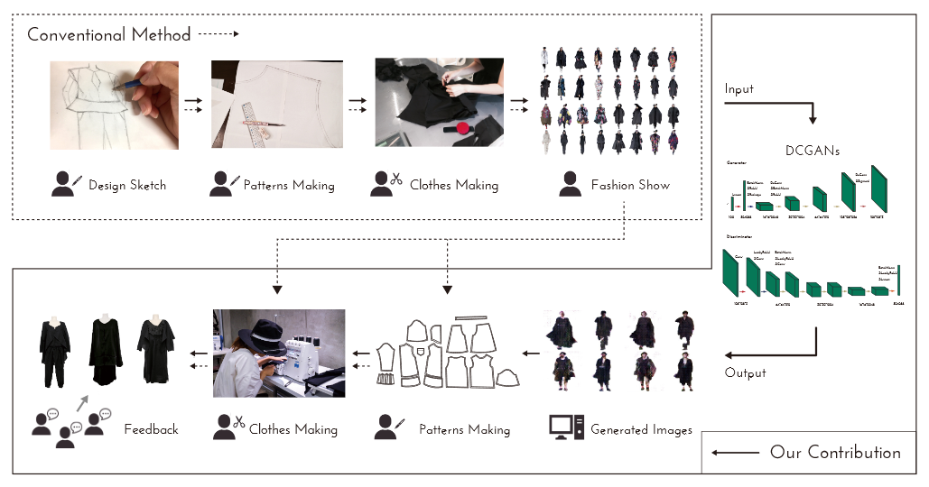
Discussion

Slide 11
Discussion
Hypothesis: Segregating the products based on brands
This introduced an extra noise (eg t-shirt picture belonging to PUMA brand) while generating different shoe(PUMA) designs
Proposed Alternate Hypothesis:Segregating the products based on different product categories and then brand if needed based on need of customer.

Slide 12
Discussion
Strengths:
Useful to learn unsupervised image representations.
Extraction of pattern from one image and superimposing into another to generate new designs.
Weakness:
The images were not of high resolution and quality though

Slide 13
Literature Survey
2. Tero Karras ,Samuli Laine, Timo Aila NVIDIA,A Style-Based Generator Architecture for Generative Adversarial Networks,
They propose an alternative generator architecture for generative adversarial networks, borrowing from style transfer literature. The new architecture leads to an automatically learned, unsupervised separation of high-level attributes (e.g., pose and identity when trained on human faces) and stochastic variation in the generated images (e.g., freckles, hair), and it enables intuitive, scale-specific control of the synthesis.
To quantify interpolation quality and disentanglement, they propose two new, automated methods that are applicable to any generator architecture.
Finally, they introduced a new, highly varied and high-quality dataset of human faces.
Notes:
Generator is designed to control the high level properties, in this case the intricate design
Discriminaitor is not redesigned as left as it is
Starts with a learned input

Slide 14
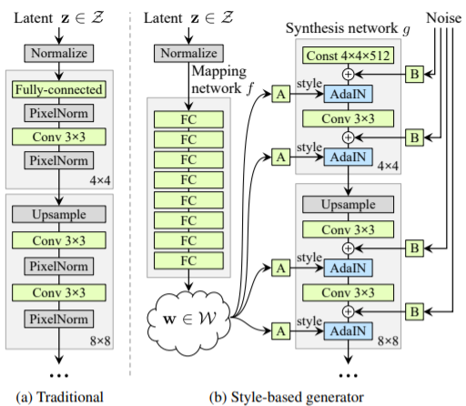
Discussion
Notes:
Learned input : controls the generator through adaptive instance normalization (AdaIN) at each convolution layer.
Adaptive Instance Normalization is a normalization method that aligns the mean and variance of the content features with those of the style features.
. Here “A” stands for a learned affine transform
“B” applies learned per-channel scaling factors to the noise input.

Slide 15
Discussion
Hypothesis:The Mapping Network’s goal is to encode the input vector into an intermediate vector whose different elements control different visual features.
This is a non-trivial process since the ability to control visual features with the input vector is limited, as it must follow the probability density of the training data. For example, if images of people with black hair are more common in the dataset, then more input values will be mapped to that feature. As a result, the model isn’t capable of mapping parts of the input (elements in the vector) to features.
In order to make the discussion regarding feature separation more quantitative, the paper presents two novel ways to measure feature disentanglement:
Perceptual path length — measure the difference between consecutive images (their VGG16 embeddings) when interpolating between two random inputs. Drastic changes mean that multiple features have changed together and that they might be entangled.
Linear separability — the ability to classify inputs into binary classes, such as male and female. The better the classification the more separable the features.

Slide 16
Discussion
Strengths:
The new generator improves the state-of-the-art in terms of traditional distribution quality metrics, leads to demonstrably better interpolation properties, and also better disentangles the latent factors of variation
High Resolution
Additional improvement of StyleGAN was updating several network hyperparameters, such as training duration and loss function, and replacing the up/downscaling from nearest neighbors to bilinear sampling.
Weakness:
Requires one or more high-end NVIDIA GPUs with at least 11GB of DRAM.

Slide 17
Literature Survey
3. Tero Karras ,Samuli Laine, Timo Aila NVIDIA,Progressively Growing GANs for improved Quality, Stability and Variation
The paper describes a new training methodology for generative adversarial networks in which the key idea is to grow both the generator and discriminator progressively: starting from a low resolution, it adds new layers that model increasingly fine details as training progresses. This both speeds the training up and greatly stabilizes it, allowing us to produce images of unprecedented quality
The paper also proposes a simple way to increase the variation in generated images, and achieve a very high inception score. Additionally, it describes several implementation details that are important for discouraging unhealthy competition between the generator and discriminator. Finally, we suggest a new metric for evaluating GAN results, both in terms of image quality and variation.

Slide 18
Discussion
Hypothesis: Most GAN networks fail to optimize the finer texture details of images since they aim to learn the large scale details of the picture as well as the finer details simultaneously. These models would then require large amounts of computation power and time before it could optimize the finer details of all images at an acceptable threshold.
This paper aims to overcome this requirement of significant computation time by spending the first few iterations learning the large scale features of the image and then adding layers to the the model. This approach significantly cuts down the number of iterations/epochs needed for generating acceptable images.
A few approaches the paper employs to further their evaluation are:
MiniBatch Standard Deviation — GANs have a tendency to capture only a subset of the variation found in training data, and Salimans et al. (2016) suggest “minibatch discrimination” as a solution.
Pixel-wise Feature Vector Normalization— To disallow the scenario where the magnitudes in the generator and discriminator spiral out of control as a result of competition, we normalize the feature vector in each pixel to unit length in the generator after each convolutional layer.

Slide 19
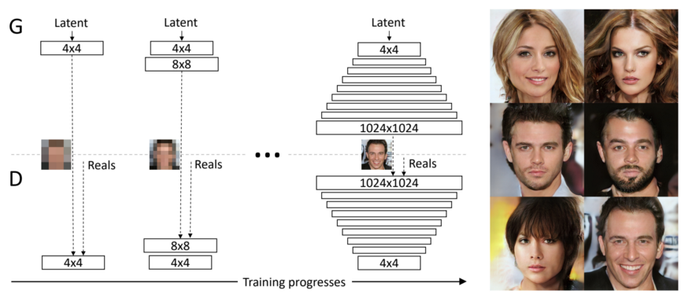

Slide 20
Literature Survey
4. Christian Ledig, Lucas Theis, Ferenc Huszar, Jose Caballero, Andrew Cunningham, Alejandro Acosta, Andrew Aitken, Alykhan Tejani, Johannes Totz, Zehan Wang, Wenzhe Shi Twitter,Photo-Realistic Single Image Super-Resolution Using a Generative Adversarial Network
The behavior of optimization-based super-resolution methods is principally driven by the choice of the objective function. Previous super resolution methods are mainly driven by the choice of the optimization function.
Most commonly used optimization target for the supervised SR algorithms is the minimization of the mean-squared error (MSE) and maximization of peak signal-to-noise(PSNR) which are defined based on the pixel-wise image differences. The PSNR ratios obtained from these methods is high but the images are perceptually not satisfying.

Slide 21
Discussion
Hypothesis: To overcome the obstacle of losing finer texture details in Super-resolution at large upscale factors, recent work has largely focused on minimizing the mean squared reconstruction error. The resulting estimates have high peak signal-to-noise ratios, but they are often lacking high-frequency details and are perceptually unsatisfying in the sense that they fail to match the fidelity expected at the higher resolution.
To achieve a high resolution with a significant upscaling factor, we propose a perceptual loss function which consists of an adversarial loss and a content loss. The adversarial loss pushes our solution to the natural image manifold using a discriminator network that is trained to differentiate between the super-resolved images and original photo-realistic images. In addition, we use a content loss motivated by perceptual similarity instead of similarity in pixel space.

Slide 22
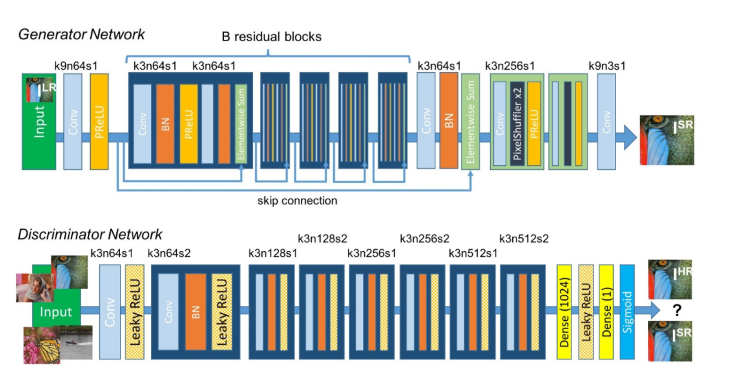

Slide 23
Discussion
Strengths:
Useful for improving quality of low-resolution images
Weakness:
mode-Collapse issue

Slide 24
Literature Survey
5. Roman Zeyde, Michael Elad, and Matan Protter,On Single Image Scale-Up Using Sparse-Representations
The goal is to recover an original image from its blurred and down-scaled noisy version. Since this problem is highly ill-posed, a prior is needed in order to regularize it.
These modifications include a major simplification of the overall process both in terms of the computational complexity and the algorithm architecture, using a different training approach for the dictionary-pair, and introducing the ability to operate without a training-set by bootstrapping the scale-up task from the given low-resolution image.

Slide 25
Hypothesis: In order to obtain the original image from the noisy scaled-down version of the image, the literature posits different ways to approach this problem ranging from simple linear space-invariant interpolation schemes (e.g., bicubic interpolation), to spatially-adaptive and non-linear filters of various sorts.

Slide 26
Strengths:
Much faster than other similar algorithms due to the use of Dimensionality Reduction and PCA
Weakness:
If the generated image is blurred, the final image will be blurred to

Slide 27
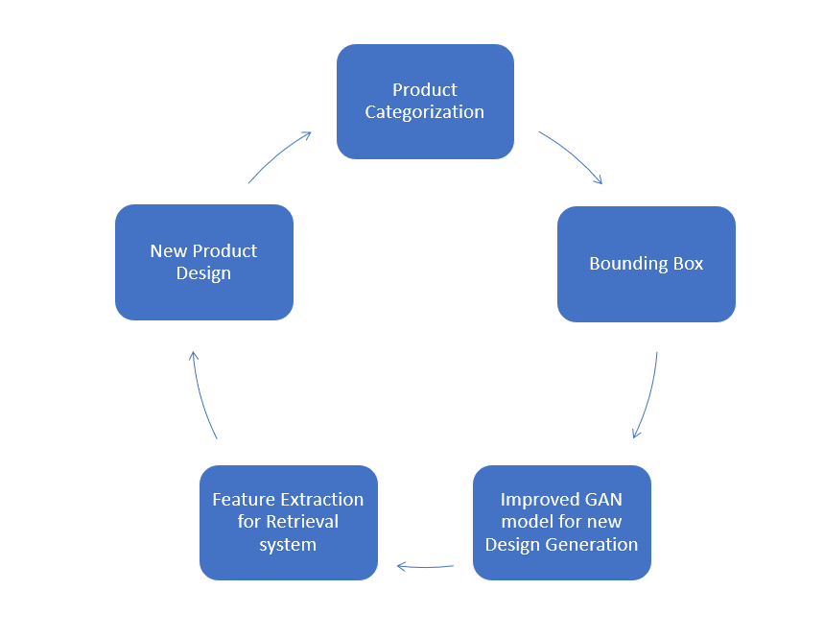
Summary of Literature Survey
Proposed Approach:
Previous research works propose different methods
to retain the patterns, colour and texture along with
certain pros and cons.
We aim to overcome those limitations and generate
new fashion apparels.

Slide 28
References
[1] Natsumi Kato, Naoya Muramatsu , Hiroyuki Osone, Yoichi Ochiai , Daitetsu Sato University of Tsukuba,DeepWear: a Case Study of Collaborative Design between Human and Artificial Intelligence
[2] Tero Karras ,Samuli Laine, Timo Aila NVIDIA,A Style-Based Generator Architecture for Generative Adversarial Networks
[3] Christian Ledig, Lucas Theis, Ferenc Huszar, Jose Caballero, Andrew Cunningham, Alejandro Acosta, Andrew Aitken, Alykhan Tejani, Johannes Totz, Zehan Wang, Wenzhe Shi Twitter,Photo-Realistic Single Image Super-Resolution Using a Generative Adversarial
Network
[4] Roman Zeyde, Michael Elad, and Matan Protter,On Single Image Scale-Up Using Sparse-Representations
[5] Alec Radford, Luke Metz, and Soumith Chintala,Unsupervised representation learning with deep convolutional generative adversarial networks In International Conference on Learning Representations (ICLR), 2016.
[6]Seyedarian Hosseini, Thomas Boquet, Wojciech Stokowiec, Ying Zhang, Christian Jauvin, Chris Pal,Fashion-Gen: The Generative Fashion Dataset and Challenge,Negar Rostamzadeh
[7] Y. Pu, Z. Gan, R. Henao, X. Yuan, C. Li, A. Stevens,and L. Carin, “Variational autoencoder for deep learning
of images, labels and captions,” in Advances in neural information processing systems, 2016, pp. 2352–2360.

Slide 29
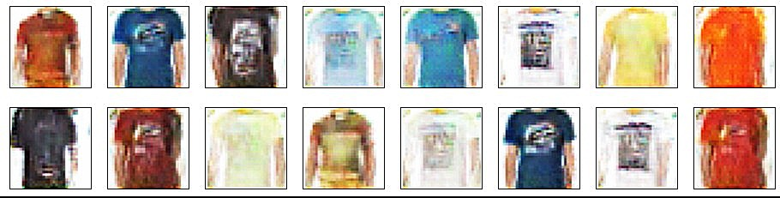
Implementation
After categorising and cropping the images we have trained DCGANs on fashion apparels to generate new T-shirts and Shirts Designs
Epoch: 900
Resolution: 32*32

Slide 30
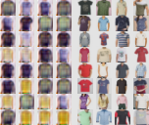
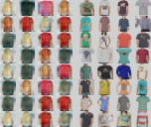
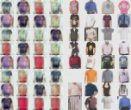
Implementation
We also trained the images against a Progressively Growing GAN, in order to perform a comparative analysis of both the approaches as mentioned in the previous review.
Epoch: 3750
Resolution: 16*16

Slide 31
Thank You

